Slide 1


Slide 2
What is Flutter?
Released in May 2017, flutter is Google’s open source mobile UI framework
Allows developers to create high-quality natively compiled applications for mobile, web, and desktop from a single codebase
It is based on Google Programming Language called Dart

Slide 3
Architecture
Flutter Engine implements Flutter's core libraries, including animation and graphics, file and network I/O, accessibility support, plugin architecture, and a Dart runtime and compile toolchain.
Flutter code is powered by the world-class Dart platform, which enables compilation to 32-bit and 64-bit ARM machine code for iOS and Android
Dart supports both AOT (Ahead Of Time) and JIT (Just In Time) compilation.
It's powered by the same hardware-accelerated Skia 2D graphics library that underpins Chrome and Android

Slide 4
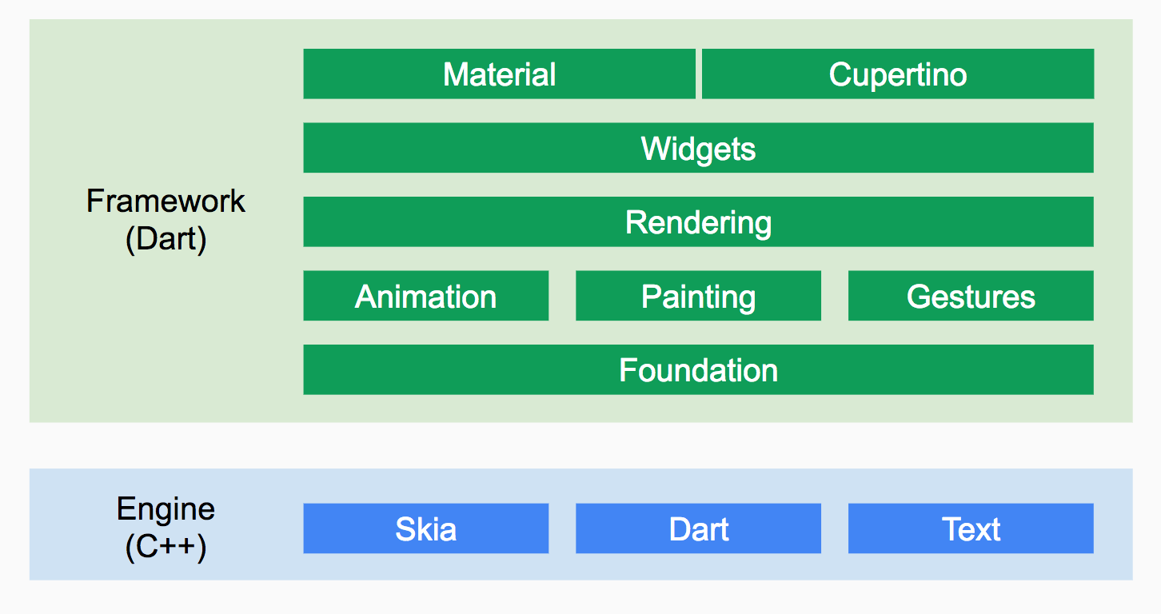
Architecture Diagram

Slide 5
Features:
Flutter uses C++ rendering engine
Architecture is based on reactive programming
Fast development:
Stateful Hot Reload
Use a rich set of fully-customizable widgets to build native interfaces
Expressive and Flexible UI

Slide 6
Continued..
Flutter engine has most of the native components in the framework itself and it doesn’t always need a bridge to communicate with the native components.
Flutter framework is bundled with UI rendering components, device API access, navigation, testing, stateful management and loads of libraries which removes the need to use third-party libraries.
Continuous delivery using Fastlane with Flutter
CI/CD support – Code Magic , Bitrise, CircleCI

Slide 7
Continued..
Native Performance:
Flutter code is compiled to native ARM machine code using Dart's native compilers
IDE:
Supportive for an extensive array of IDEs that include Xcode, Visual Studio Code and Android Studio
You get the extra support for Google’s Firebase development platform.

Slide 8
Everything’s a widget
Widgets are the basic building blocks of a Flutter app’s UI.
Each widget nests inside, and inherits properties from, its parent.
A widget is either stateful or stateless:
A Stateful widget is dynamic: e.g., it can change its appearance in response to events triggered by user interactions or when it receives data.
Stateless widgets do not require mutable state, i.e., it is immutable.

Slide 9
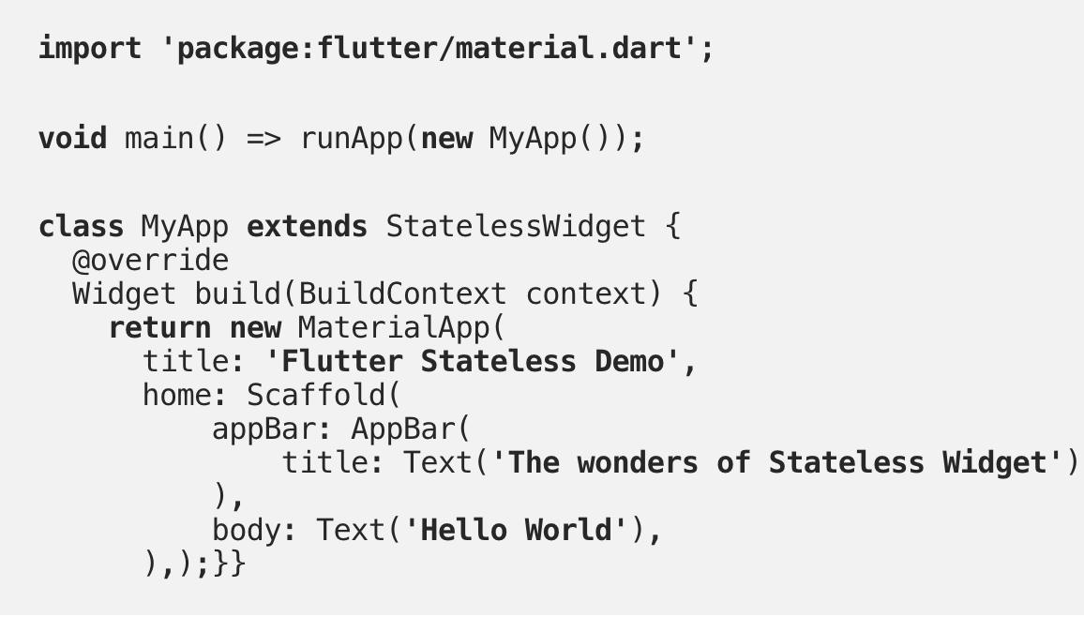
Stateless widget

Slide 10
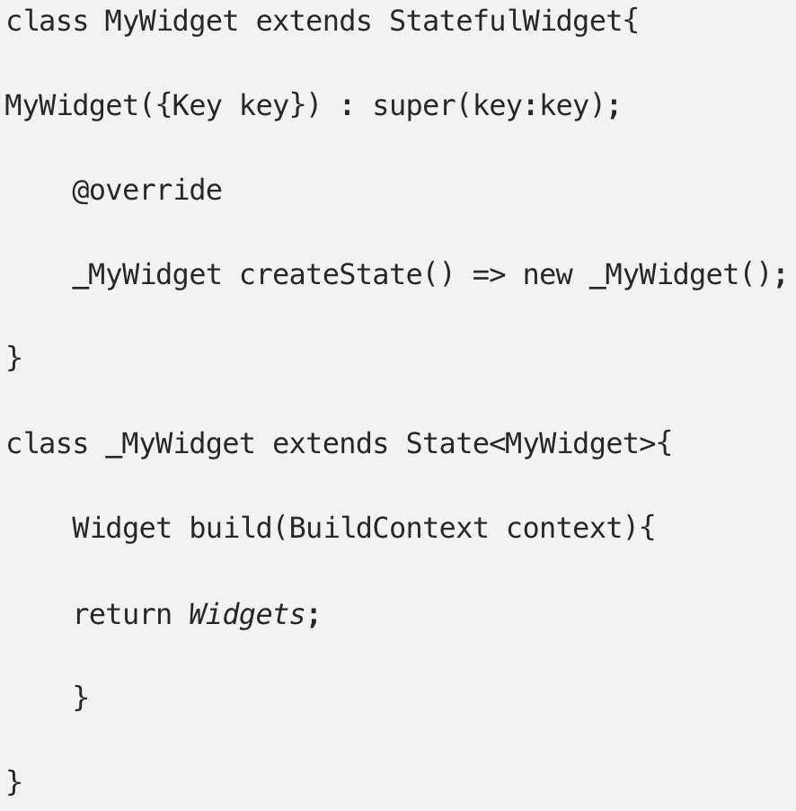
Stateful widget

Slide 11
Installation
https://flutter.dev/docs/get-started/install/macos

Slide 12
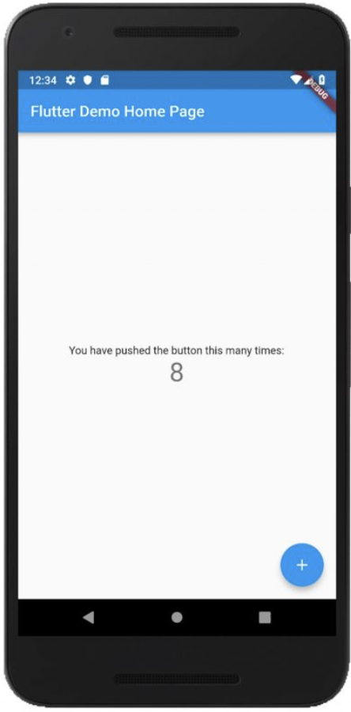
Create and run a simple Flutter app
$ flutter create my_app
$ cd my_app
$ flutter run

Slide 13
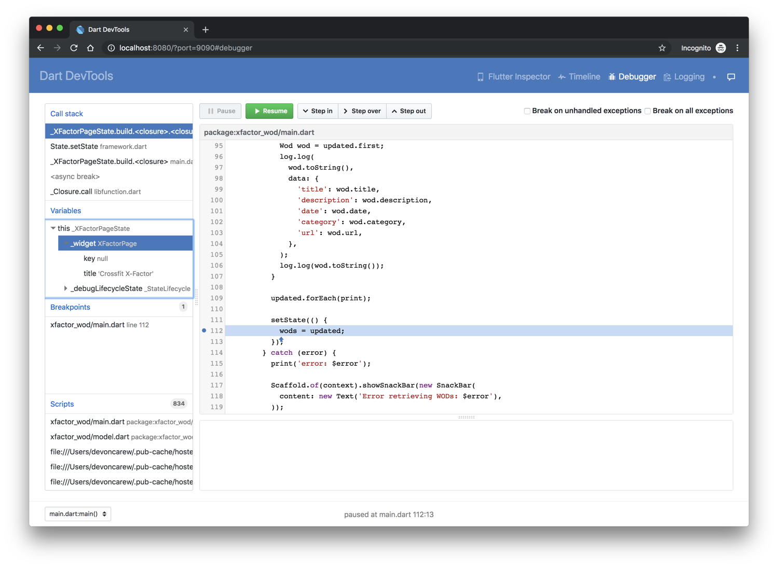
Debugging
DevTools includes a full source-level debugger, supporting breakpoints, stepping, and variable inspection.

Slide 14
Pros
Ready-made and custom widgets for fast UI coding
Single codebase for web, mobile and embedded platforms
Dart – simple and effective language targeted at Java programmers
Hot reload function for instantaneous updates
The mildest learning curve and a growing community
More Firebase APIs assistance
Excellent User Interfaces
Perfect for an MVP (minimum viable product)

Slide 15
Cons
Since it is coded in Dart language, a developer needs to learn new language.
Lack of third-party libraries
Large number of open issues in GitHub (5000+)
Image I/O can be expensive
Flutter caters to mobile apps only and isn’t supported by web browsers.

Slide 16









Who is using Flutter?
Google Ads
Reflectly
JD Finance

Slide 17
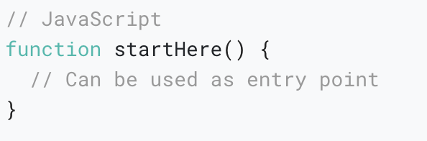
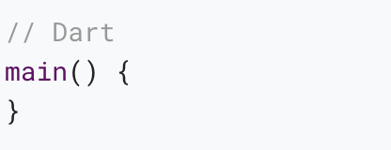
Flutter vs React Native
Entry point

Slide 18
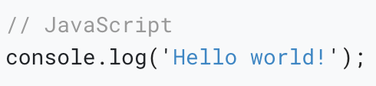

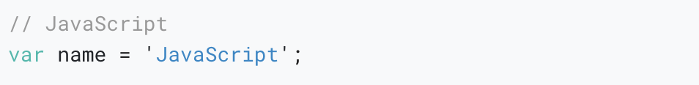
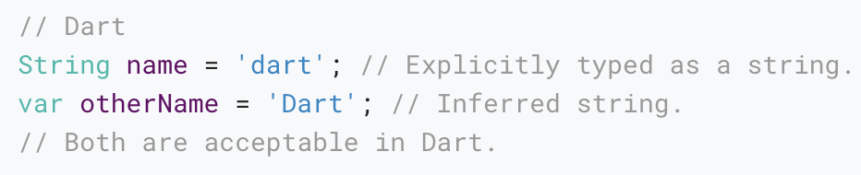
Printing to the console
Variables

Slide 19
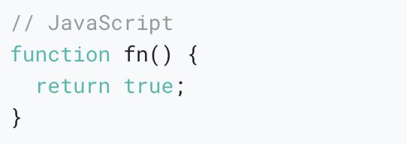
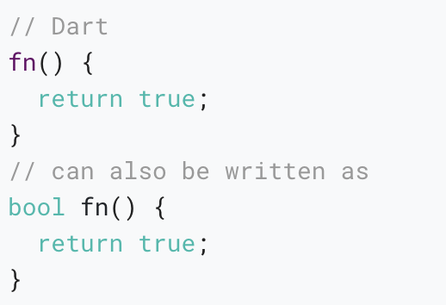
Functions

Slide 20
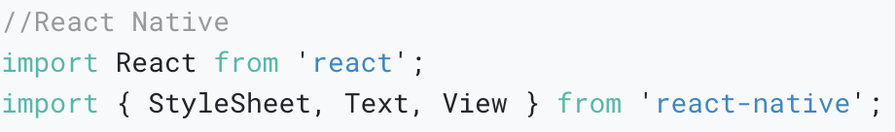
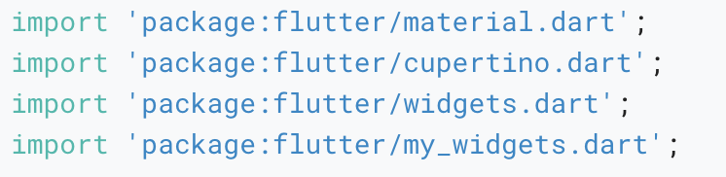
Import
// Dart

Slide 21
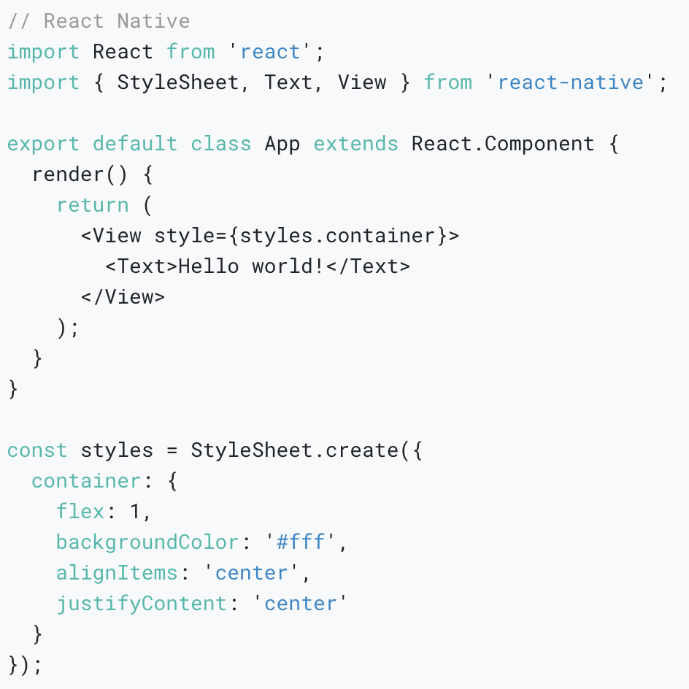
Hello World Example:
React Native

Slide 22
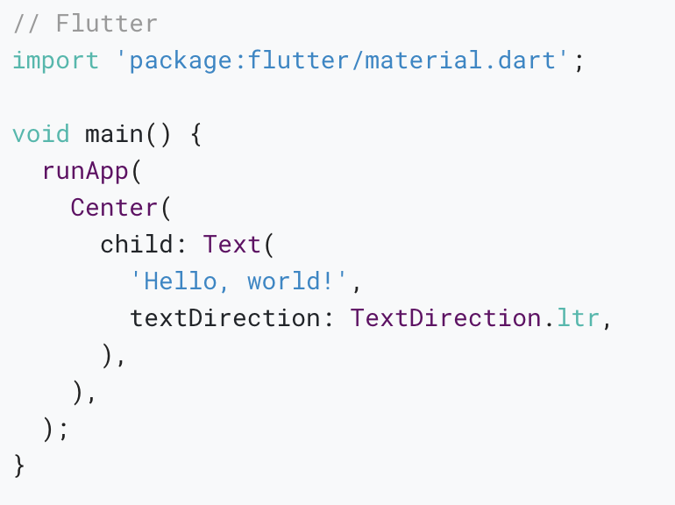
Hello World Example:
Flutter

Slide 23
Documentation & Community Support
https://flutter.dev/docs/get-started/install
https://flutter.dev/docs/development/ui/widgets
https://flutter.dev/docs/get-started/flutter-for/react-native-devs
https://api.flutter.dev/
https://github.com/flutter/samples/blob/master/INDEX.md
https://www.youtube.com/flutterdev

Slide 24
Thank You!!

